Slide 1

Chemical Reactor Network Modelling For Iron Particle Combustion Bachelor Thesis Project – 1
Submitted by : Mudavath Simhachal (22MF3IM12)
Supervisor Prof : Mani Kalyani Ambatipudi
Department of Mechanical Engineering
IIT Kharagpur, March 2026

Slide 2
Introduction
Metal fuels such as iron powder are promising alternatives for clean energy
When iron reacts with oxygen, it releases significant heat energy
Iron combustion can be used for carbon-free energy systems
Iron powder is especially promising due to its practicality

Slide 3
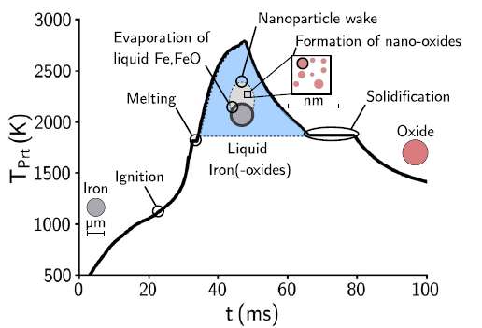
Challenges in modelling Iron Combustion
Multi-phase system (solid + gas)
Multiple processes:
Heating, melting, oxidation, evaporation
Oxidation pathway:
Fe → FeO → Fe₃O₄ → Fe₂O₃
Strong coupling between heat, mass transfer, and reactions
Conclusion: Direct simulation is complex and computationally expensive

Slide 4
Why Iron Is A Good Fuel
Non-toxic
High energy density
Already produced in large quantities
Can be recycled
Iron cycle:
Iron → Burn → Iron Oxide → Recycle using Hydrogen → Iron again
This creates a circular energy system

Slide 5
Experimental Setup :
Setup used:
Laboratory-scale combustion chamber
Methane-assisted iron dust flame
Swirling air flow for mixing
Purpose of study:
flame structure
Study oxygen distribution
Investigate pollutant formation
Results compared with:
CFD simulations and LES data.

Slide 6
Models Used in Study :
Two oxidation models.
1. FOSK Model
First Order Surface Kinetics
oxidation occurs at the particle surface
reaction depends on oxygen diffusion
2. Reactive Cooling Model
considers layered oxide structure
includes evaporation effects
captures detailed particle physics
These models simulate iron particle conversion during combustion.

Slide 7
What is a Chemical Reactor Network (CRN)?
A CRN is a combination of simple reactors used to represent a complex combustion system.
Reactor types :
1. Perfectly Stirred Reactor (PSR)
Complete mixing
Used for recirculation zones
2. Plug Flow Reactor (PFR)
One-directional (plug) flow
No axial mixing
PSR + PFR together simulate real combustion chamber behavior
CRN has been successfully applied to iron particle combustion in literature

Slide 8
Objective of This Work
Develop CRN models for iron combustion
Advantage:
Lower cost than CFD
However, iron combustion is highly complex due to multi-phase interactions.

Slide 9
0D Reactor as a starting point
A 0D Ideal Gas Reactor is used
Perfect mixing
No spatial variation
Only time-dependent changes
0D reactor :
Basically similar to a PSR concept (perfect mixing)
A simplest reactor model
Used as the simplest CRN element to understand combustion behavior

Slide 10
Conclusions :
From Literature (Iron CRN):
CRN models iron combustion effectively
Oxygen controls reaction
Temperature affects NOx & evaporation.
Particle size affects evaporation

Slide 11
Thank you

